Slide 1
Graphics and Statistical tests in R
R programming
Session 3
Harvard Medical School
Lijian Yu, PhD
lijian_yu@dfci.harvard.edu

Slide 2
This ppt on GitHub
https://github.com/lijian007/RClass.git
Download "R programming III.pptx"

Slide 3
R environment
Notepad++ (http://notepad-plus-plus.org/)
R (http://cran.r-project.org/bin/windows/base/)

Slide 4
Session outline
Base R Graphics
ggplot2
Test seletion
Statistical tests
reshape2

Slide 5
mtcars
A data frame with 32 observations on 11 variables.
[, 1]mpg Miles/(US) gallon
[, 2]cyl Number of cylinders
[, 3]disp Displacement (cu.in.)
[, 4]hp Gross horsepower
[, 5]drat Rear axle ratio
[, 6]wt Weight (lb/1000)
[, 7]qsec 1/4 mile time
[, 8]vs V/S (vertical or straight engines)
[, 9]am Transmission (0 = automatic, 1 = manual)
[,10]gear Number of forward gears
[,11]carb Number of carburetors
1974 Motor Trend

Slide 6
Graphics in base R
head(mtcars)
try:
plot(mtcars$mpg)
plot(sort(mtcars$mpg))
plot(mtcars$wt)
plot(sort(mtcars$wt))
tail(mtcars[order(mtcars$wt),])

Slide 7
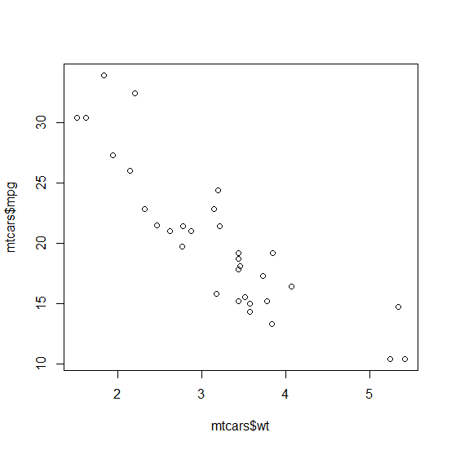
Scatter plot in base R
Is there a relationship between mpg and wt?

Slide 8
Scatter plot in base R
Is there a relationship between mpg and wt?
plot(mtcars$wt ,mtcars$mpg)
abline(lm(mpg~wt,data=mtcars), col="red")
head(mtcars[order(mtcars$mpg),])

Slide 9
Exercise: explore the relationship of mpg and hp
Is there a relationship between mpg and hp?
What is the most powerful car? What is its rank of mpg?

Slide 10
How to save a graph?
File->save
or by codes:
png(“.../mygraph.png”, width=5, height=5, units="in", res=300)
plot(mtcars$mpg,mtcars$wt)
dev.off()

Slide 11
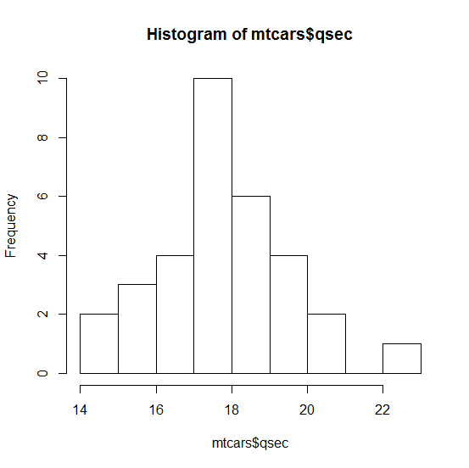
Histogram in base R:What's the distribution of qsec?

Slide 12
Histogram in base R
What’s the distribution of qsec?
hist(mtcars$qsec)

Slide 13
Exercise: Is qsec related to cyl or mpg or hp?

Slide 14
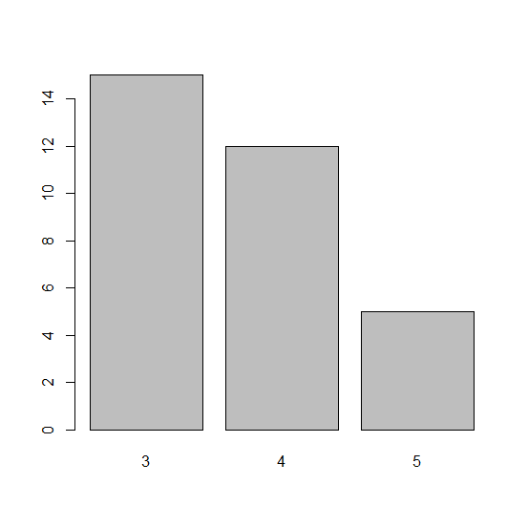
bar graph in base R
What’s the distribution of gears in our data?

Slide 15
bar graph in base R
What’s the distribution of gears in our data?
hist(mtcars$gear)
(tab<-table(mtcars$gear))
barplot(tab)

Slide 16
Exercise: What’s the distribution of cyl in our data (histogram)?

Slide 17
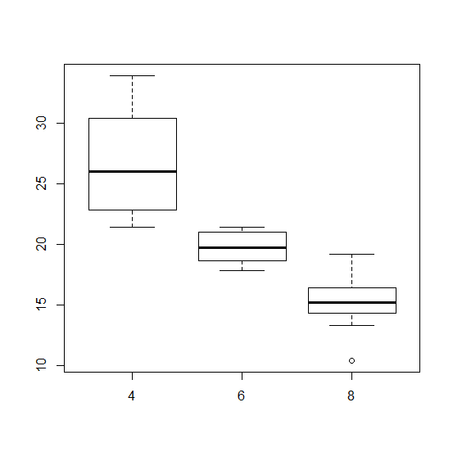
What’s the relationship between mpg and cyl (boxplot)?

Slide 18
What’s the relationship between mpg and cyl (boxplot)?
plot(mtcars$cyl, mtcars$mpg)
boxplot(mpg~cyl,data=mtcars)

Slide 19
Test selection chart for independent samples
Predictor | Outcome | Analysis
dichotomous | continuous | t-test / Wilcoxon rank sum test
categorical | continuous | ANOVA / Kruskal-Wallis test
continuous | continuous | linear regression / Spearman correlation coefficient
dichotomous | dichotomous | χ2 test/Fisher's exact test
categorical | dichotomous | χ2 test/Fisher's exact test
continuous | dichotomous | Logistic regression
dichotomous | time-to-event | Log-rank test
categorical | time-to-event | Cox-PH regression
continuous | time-to-event | Cox-PH regression

Slide 20
Is wt and mpg correlated?
plot(mtcars$wt ,mtcars$mpg,xlim=c(0,8),ylim=c(0,40))
continuous predictor, continuous outcome
linear regression
fit<-lm(mpg~wt,data=mtcars)
summary(fit)
abline(fit, col="blue")

Slide 21
Is cyl related to qsec?
plot(factor(mtcars$cyl) ,mtcars$qsec)
categorical predictor, continuous outcome
anova test
anova(lm(mpg~factor(cyl),data=mtcars))
summary(aov(mpg~factor(cyl),data=mtcars))

Slide 22
Are vertical engines (vs=0) more efficient than straight engines(vs=1)?
plot(mtcars$vs ,mtcars$mpg)
plot(factor(mtcars$vs),mtcars$mpg)
dichotomous predictor, continuous outcome
t test
t.test(mpg~vs,data=mtcars)
Confounders?

Slide 23
Is vs related to cyl?
plot(factor(mtcars$vs),mtcars$cyl)
table(mtcars$vs,mtcars$cyl)
categorical predictor, dichotomous outcome
Fisher's exact test
fisher.test(mtcars$vs,mtcars$cyl)

Slide 24
ggplot2
require(ggplot2)
you may need: install.packages("ggplot2")
layered graphs

Slide 25
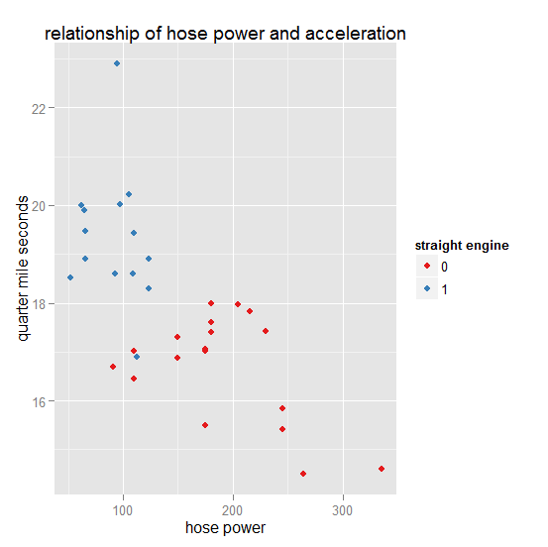
Scatter plot: hp vs.qsec

Slide 26
Scatter plot: hp vs.qsec
ggplot(mtcars, aes(x=hp, y=qsec, color=factor(vs))) + geom_point() + scale_colour_brewer(palette="Set1")+xlab("hose power")+ylab("quarter mile seconds")+ggtitle("relationship of hose power and acceleration")+ guides(color=guide_legend(title="straight engine"))

Slide 27
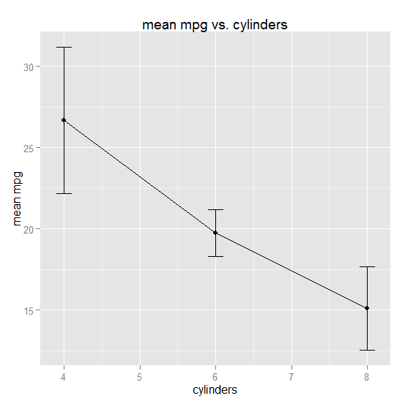
Line graphs:mean mpg vs. cylinders

Slide 28
Line graphs:mean mpg vs. cylinders
require(plyr)
results<-ddply(mtcars,"cyl",function(x)c(mean(x$mpg),sd(x$mpg)))
colnames(results)<-c("cyl","MeanMpg","Std")
ggplot(results, aes(x=cyl,y=MeanMpg)) + geom_point() +geom_line() + geom_errorbar(aes(ymin=MeanMpg-Std,ymax=MeanMpg+Std),width=0.2) +xlab("cylinders")+ylab("mean mpg")+ggtitle("mean mpg vs. cylinders")

Slide 29
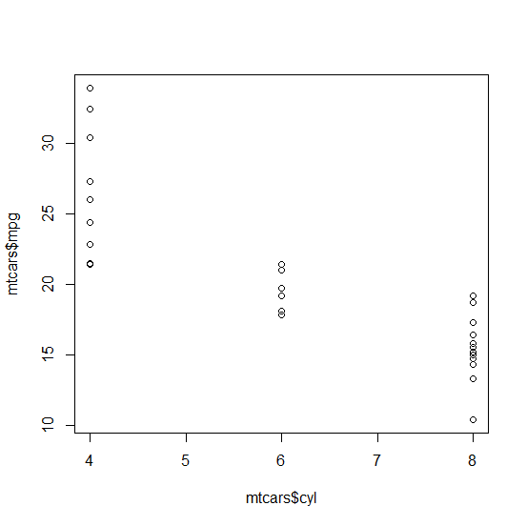
What’s the relationship between mpg and cyl (boxplot)?
plot(mtcars$cyl, mtcars$mpg)
boxplot(mpg~cyl,data=mtcars)
How to overlap the dot plot and box plot?

Slide 30
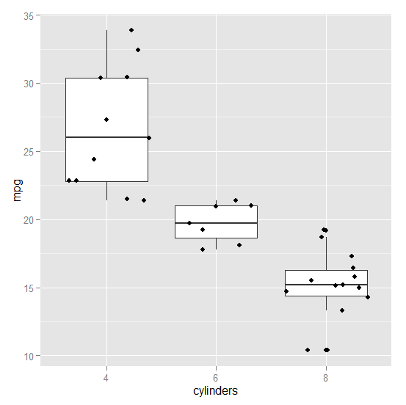
Overlap the dotplot and boxplot

Slide 31
Overlap the dotplot and boxplot
ggplot(mtcars, aes(x=factor(cyl), y=mpg))+ geom_boxplot() + geom_point(position="jitter") + xlab("cylinders") + ylab("mpg")

Slide 32
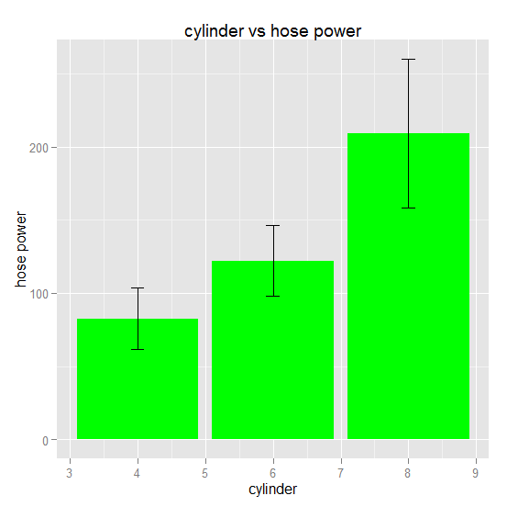
Use bar graphs to draw the relationship of hp and cylinders

Slide 33
Bar graphs: hp vs. cylinders
results<-ddply(mtcars,"cyl",function(x)c(mean(x$hp),sd(x$hp)))
colnames(results)<-c("cyl","MeanHp","StdHp")
ggplot(results, aes(x=cyl, y=MeanHp)) + geom_bar(stat="identity",fill="green") +xlab("cylinder")+ylab("hose power")+ggtitle("cylinder vs hose power")+ guides(color=guide_legend(title="straight engine"))+geom_errorbar(aes(ymin=MeanHp-StdHp,ymax=MeanHp+StdHp),width=0.2)

Slide 34
Data transformation Example
infile="C:/temp/Rclass/PatientGeneExpression.txt"
gept<-read.table(infile,header=T,sep="\t",quote="\"",comment.char = "", stringsAsFactors=FALSE, blank.lines.skip=T)
head(gept)

Slide 35
Data transformation Example
ID | mutation | Sub1 | Oxr1 | Sod1
PT001 | 0 | 5.17 | 7.425 | 4.325
PT002 | 0 | 3.114 | 3.454 | 0.482
PT003 | 0 | 10.692 | 6.859 | 1.972
PT004 | 0 | 9.735 | 8.638 | 5.155
PT005 | 0 | 5.936 | 3.209 | 1.661
PT006 | 0 | 8.316 | 4.788 | 4.475
PT007 | 1 | 0.858 | 1.212 | 8.872
PT008 | 0 | 6.148 | 9.409 | 3.306
PT009 | 1 | 10.222 | 2.36 | 6.407
PT010 | 0 | 5.478 | 2.023 | 3.359
head(gept,10)

Slide 36
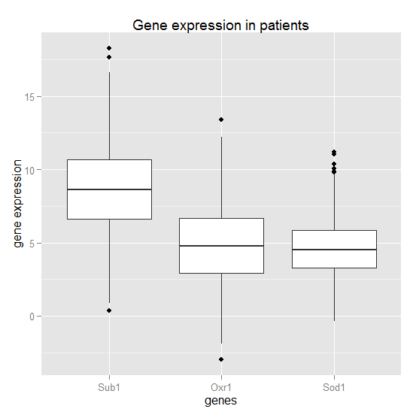

Slide 37
transform data to the long form
require(reshape2)
geplong<-melt(gept,id.vars=c("ID","mutation"))
colnames(geplong)<-c("ID","mutation","genes","value")
ggplot(geplong, aes(x=genes, y=value)) + geom_boxplot() +xlab("genes") + ylab("gene expression") + ggtitle("Gene expression in patients")

Slide 38
transform data to the long form
ggplot(geplong, aes(x=genes, y=value, color=factor(mutation))) + geom_boxplot() +xlab("genes") + ylab("gene expression") + ggtitle("Gene expression in patients") + scale_colour_brewer(palette="Set1") + guides(color=guide_legend(title="mutation"))

Slide 39
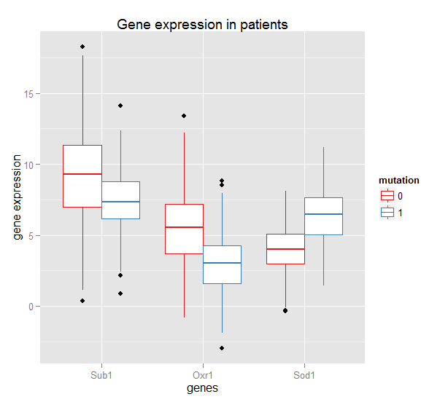

Slide 40
Does the mutation affect gene expression?
head(gept)
head(geplong)
anova(lm(value~factor(mutation)+factor(genes),data=geplong))

